Slide 1
State Observer – Kalman Filter for Estimation
METU-Aeçelik 2244 program
Serhat Özküçük

Slide 2
Kalman Filter
A Kalman Filter is an OPTIMAL ESTIMATION algorithm
Kalman filter is used when;
  The variables of interest can only be measured indirectly.
  Measurements are available from various sensors but might be subject to noise or disturbance.

Slide 3
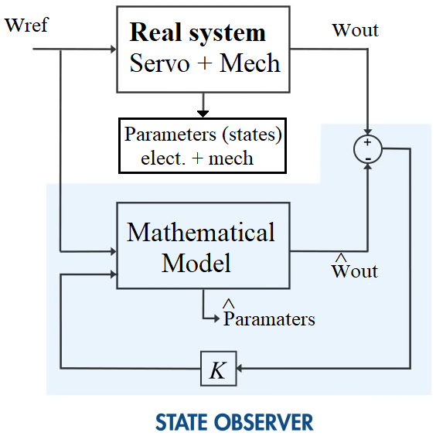
State Observers (for Understanding Kalman)

Slide 4
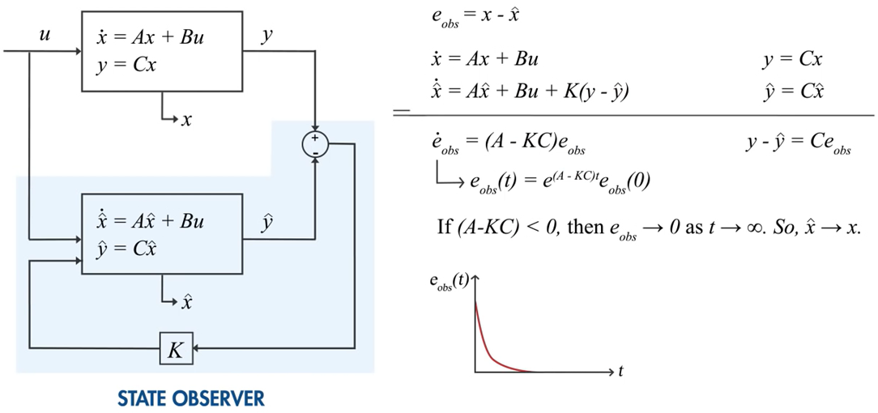
State Observers (generalized)

Slide 5
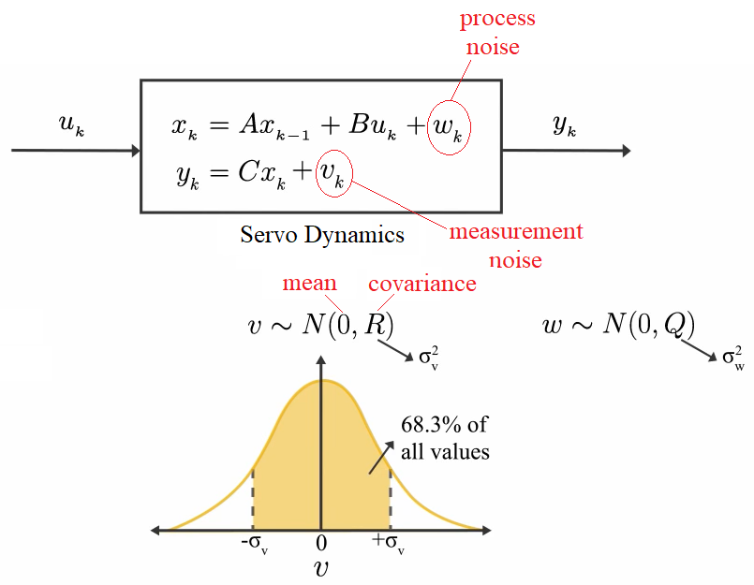
State Observer with noise -> KALMAN
There are always measurement noise (v) and process noise (w) in the system.
Generally (from probability theory), noise characteristics are assumed as Gaussian distribution with zero mean and R covariance

Slide 6
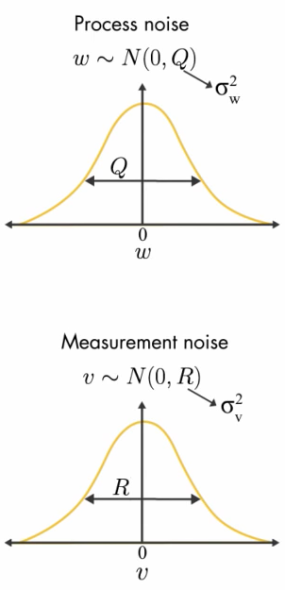
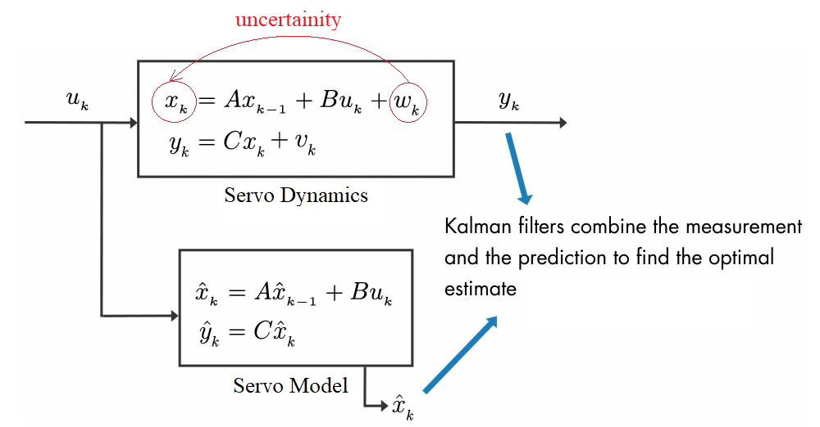
Kalman Filter

Slide 7
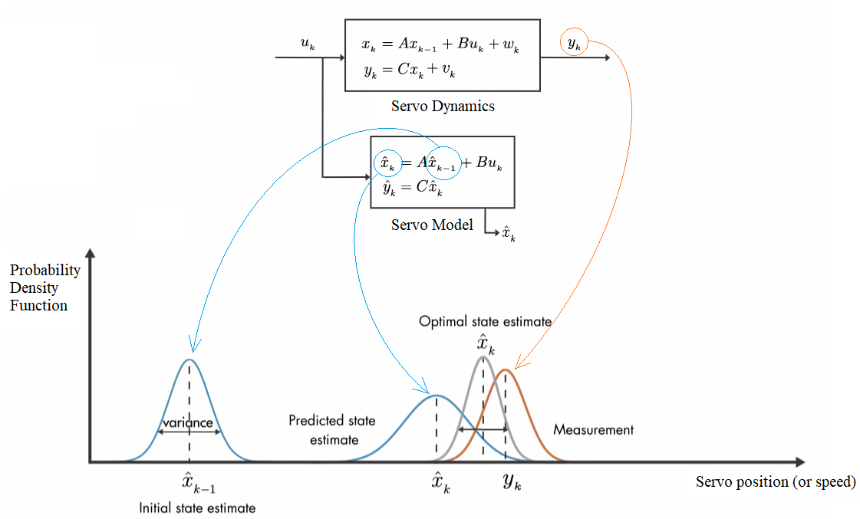
Kalman Filter
Combining two pieces of data:
Predicted state estimate
Measurement
For ex: Multiplying two prob. Dens. Func. together -> Optimal State Estimate

Slide 8
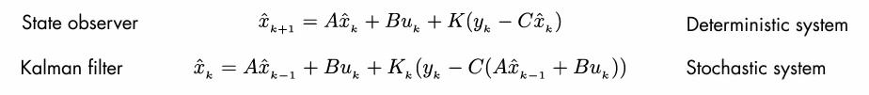
Mathematical theory - Kalman
A deterministic system is a system
in which no randomness is involved
in the development of future states
of the system. A deterministic model
will thus always produce the same
output from a given starting condition
or initial state.
For a system to be stochastic,
one or more parts of the system has
randomness associated with it.

Slide 9
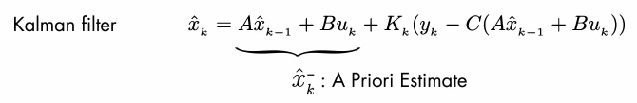
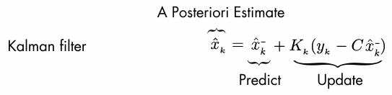
Kalman: Prediction - Update

Slide 10
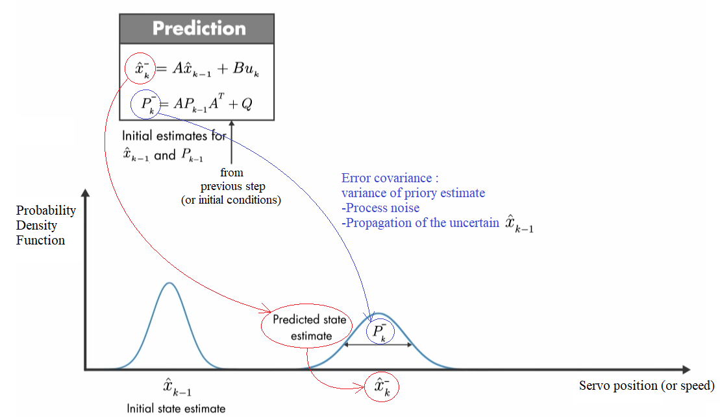
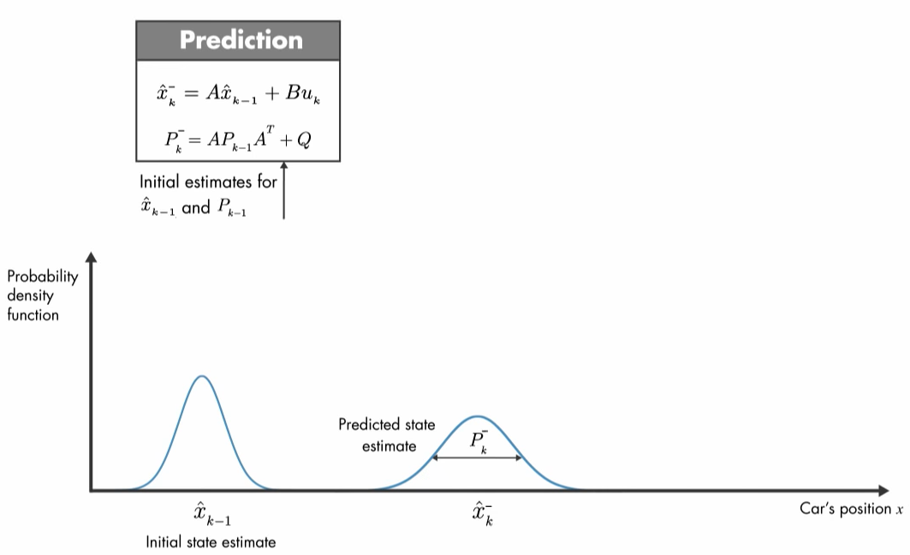
Prediction

Slide 11
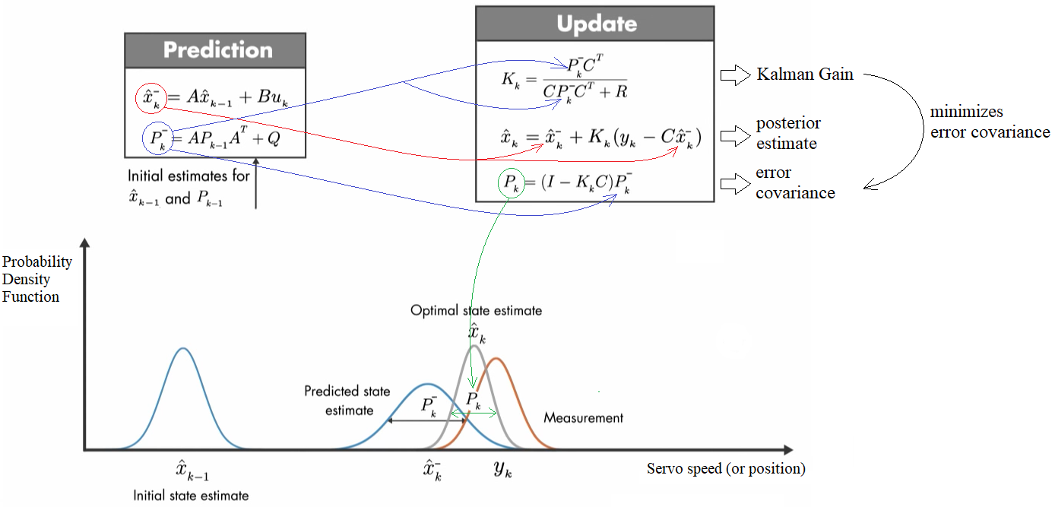
Update

Slide 12
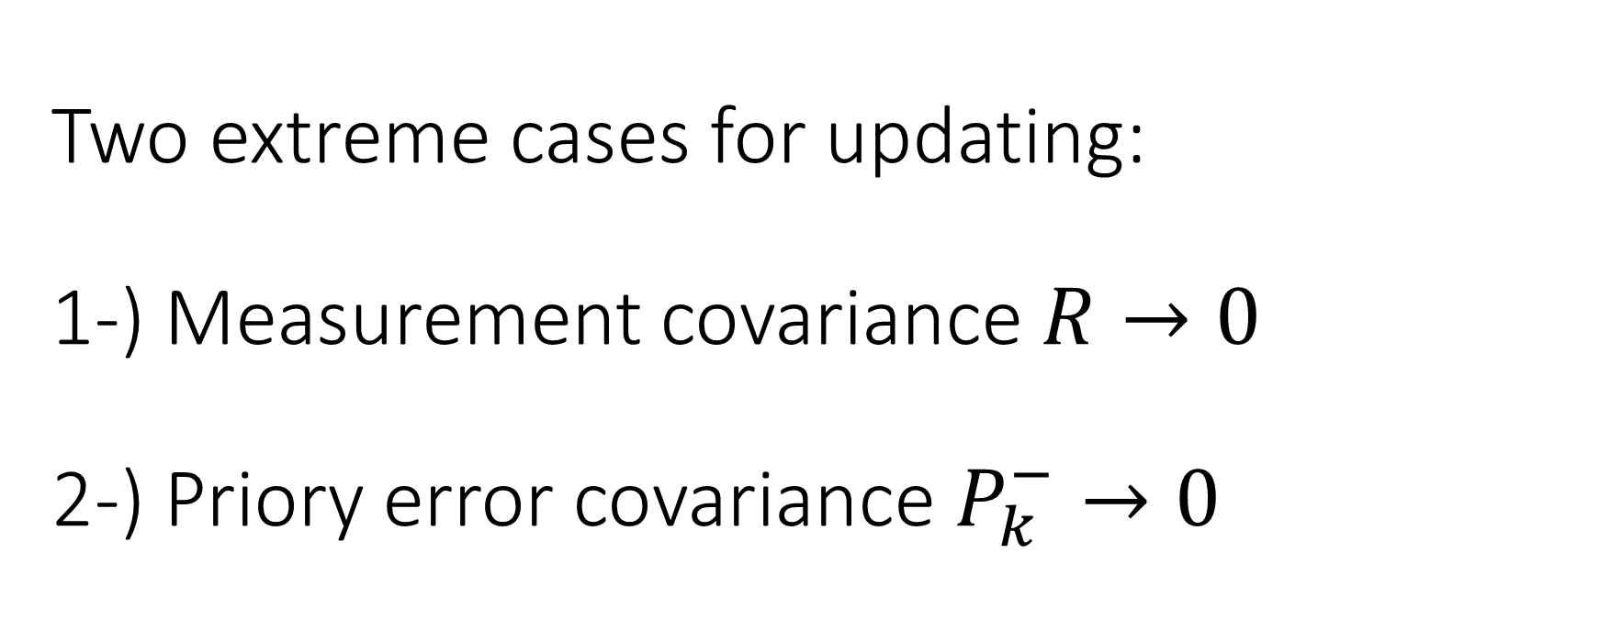
Two extreme cases for updating:
1-) Measurement covariance $R→0$
2-) Priory error covariance $P_{k}^{−}→0$

Slide 13
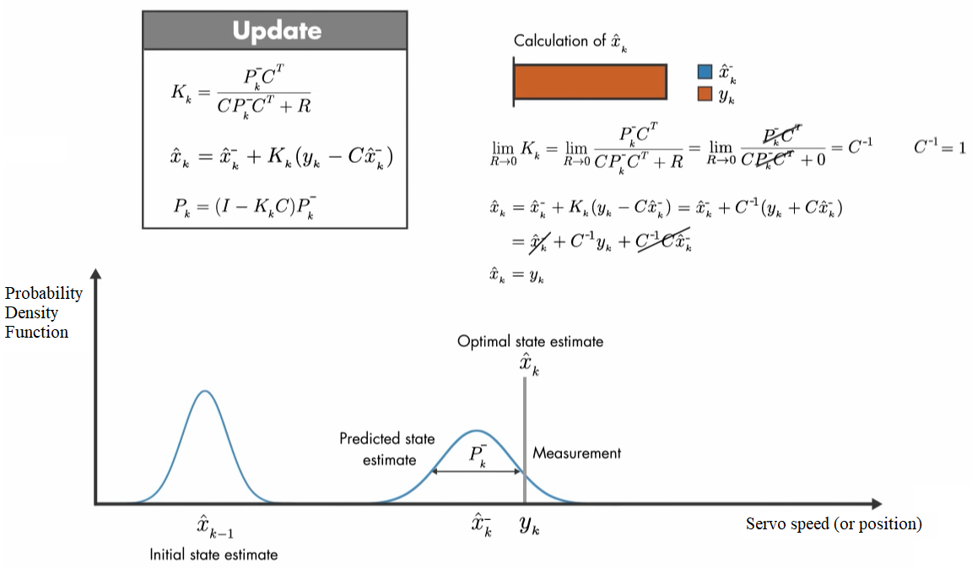
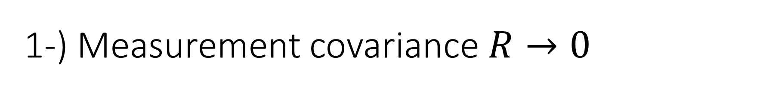
1-) Measurement covariance $R→0$

Slide 14
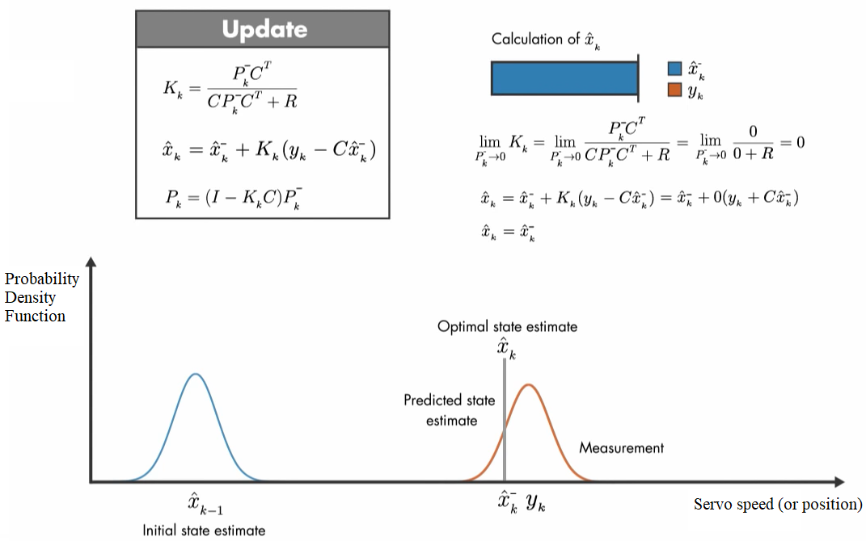
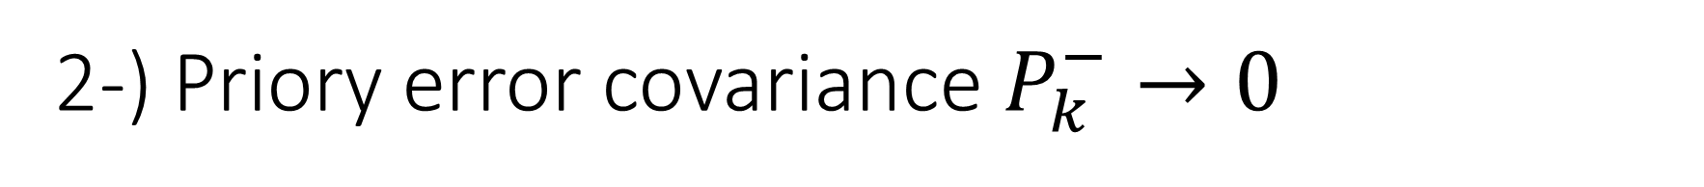
2-) Priory error covariance $P_{k}^{−}→0$

Slide 15
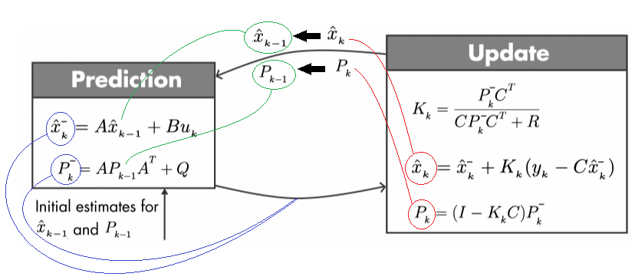
Recursive operation of Kalman

